Slide 1

AMIS flying the Oracle JET
Lucas Jellema (CTO AMIS & Oracle Developer Champion)
Sunday October 1st, Oracle OpenWorld 2017, San Francisco
Notes:
Hi all,
In https://events.rainfocus.com/catalog/oracle/oow17/catalogoow17, our discussion panel is listed, at this date, time, and location:
Sunday, Oct 01,
3:45 p.m. - 4:30 p.m.
Marriott Marquis (Yerba Buena Level) - Salon 13
Here’s the abstract: "Oracle JavaScript Extension Toolkit is a modern architecture for front-end JavaScript development. Where ever an Oracle organization uses JavaScript for web or mobile development, they use Oracle JavaScript Extension Toolkit to solve common enterprise problems. However, what are organizations outside Oracle doing with Oracle JavaScript Extension Toolkit? In this session meet representatives from organizations where Oracle JavaScript Extension Toolkit is used, and let them show you the places where they're using Oracle JavaScript Extension Toolkit; what their mix of technology, architectures, and clouds is; and discuss with them the applicability of Oracle JavaScript Extension Toolkit in your context. Prepare to come to this session with questions!”
In short, we have 45 minutes in total. I propose that we focus on keeping the discussion as informal as possible. We’ll all be on the stage at the same time, sitting, and just chatting. We should let the audience interact as much as possible.
To give some structure, I suggest that Andrejus, Luc, Lucas, and Filip each spend about 5 minutes introducing their organization, the work they’ve done with JET, with at most two slides each, and preferably a demo of an application that is in production, focusing on the strengths of JET.
Potential questions we can discuss, feel free to suggest others:
- Why did you start using JET in the first place?
- What are its strengths in your business scenario?
- How productive is JET for you?
- How does JET relate to ADF, APEX, and Forms?
- How does JET fit with other Oracle Cloud technologies?
Interested in anyone else’s thoughts, disagreements, and additions!

Slide 2
Overview AMIS
AMIS is Oracle Platinum Partner from The Netherlands
Founded in 1991
Providing consultancy and managed service around Oracle technology
Key proposition: SaaS enablement
Long history of embracing the future
Oracle Forms, Open Source Java, ADF, Rich Web Client (HTML5, Angular, Ionic), JET, VBCS
Eager to share knowledge
technology.amis.nl/blog (since 2004, 3000 articles, 6000 visitors.day)
9 sessions at OOW 2017
Cloud is where we are going

Slide 3
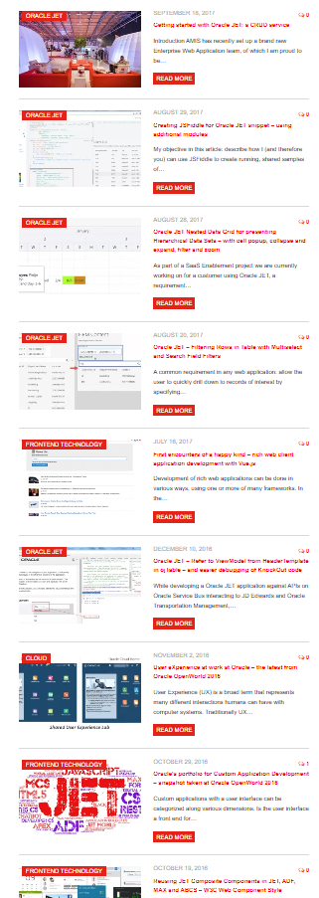
AMIS and Oracle JEt
First formal encounter – Oracle OpenWorld 2015
Explored early previews – internal workshop, external community sessions
Participated in MOOCs, published some blog articles
Extended Nested Data Grid, how to create JS Fiddle, Client Side Event Bus, …
Prototype for customer (2016): User Interface embedded in JD Edwards with data from custom database, JD Edwards and OTM
Production application for customer (2017):
User Interface embedded in Oracle WebCenter Portal – visualization of complex data from ERP system (exposed through Elastic Search Index)
Started Enterprise UI unit for Rich Web Client development – focusing on Oracle JET& HTML5/JavaScript/APIs (mainly for SaaS Enablement)
September 2017: Trained five new hires on Oracle JET
Notes:
https://technology.amis.nl/tag/jet/

Slide 4
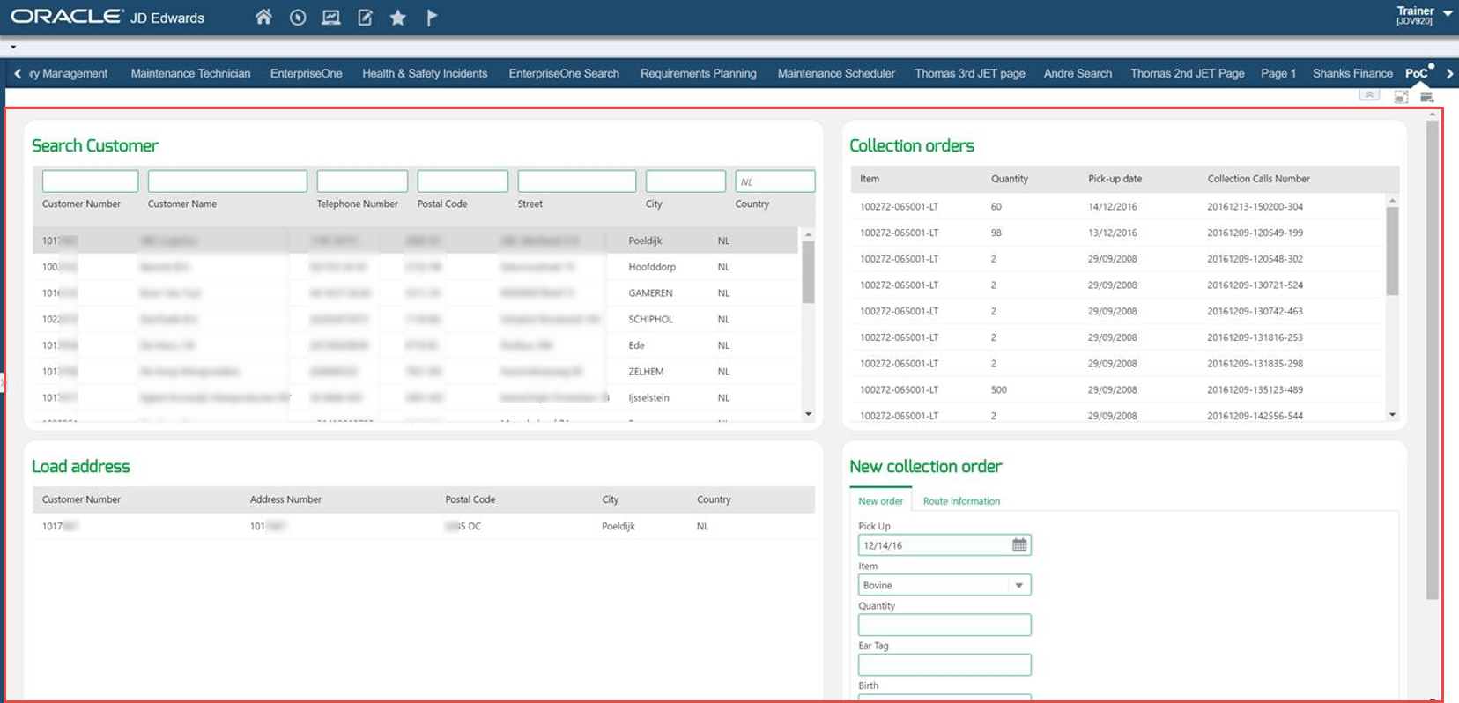


CASE: Oracle JET for user interfaces on top of ERP & SaaS – for example JD Edwards
Custom App

Slide 5
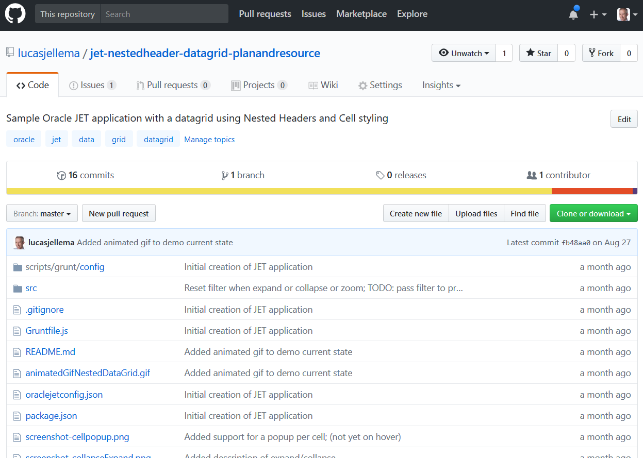
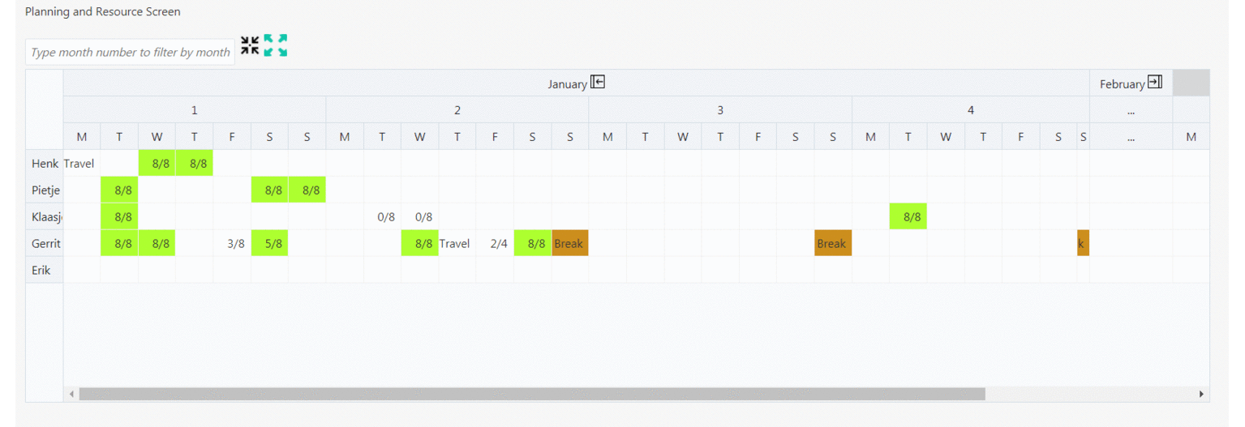
Applied and extended the nested [header] data grid (and shared)

Slide 6
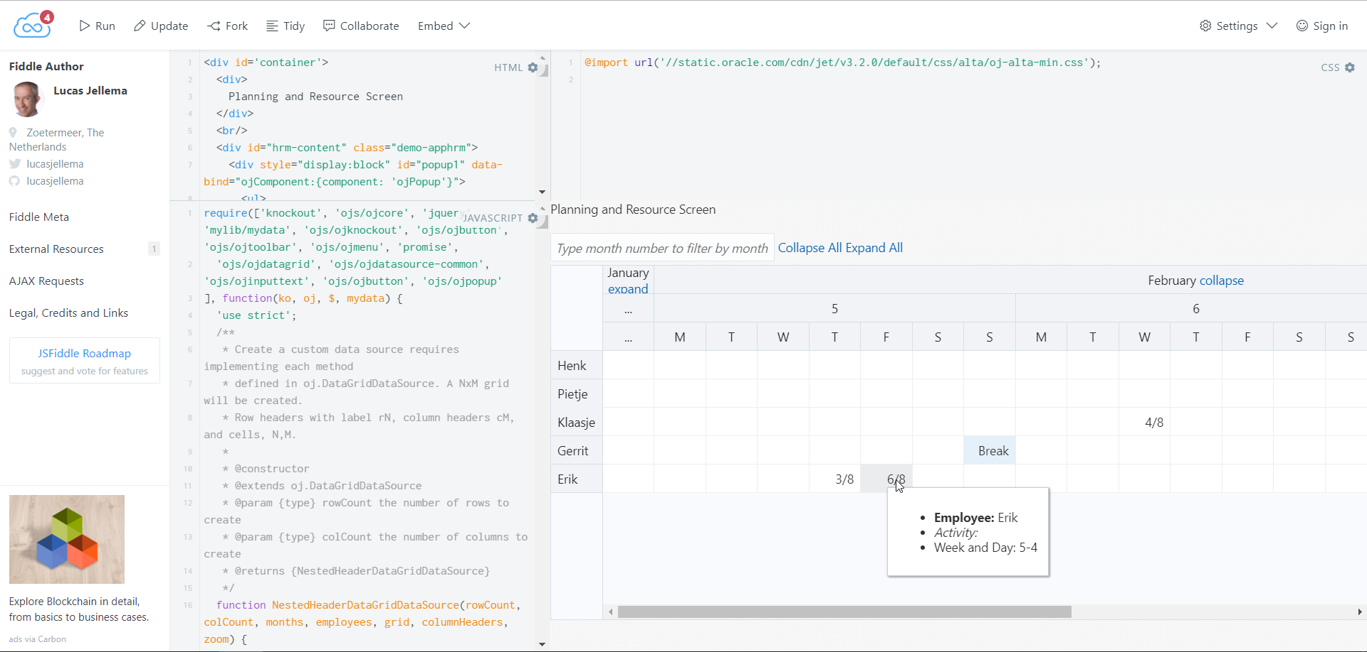
JS Fiddle for Oracle JET Sharing extended nested data grid
Notes:
https://jsfiddle.net/lucasjellema/L335cfwd/3/?utm_source=website&utm_medium=embed&utm_campaign=L335cfwd

Slide 7











Case: [data from] On premises 3rd party ERP needs to be exposed in tailor made UI
Users
Portal
ElasticSearch
Data Sync
MW Svc
IFS
Back-end
System
Rental
Rental
Planning
Planning
Reference
HTML
JavaScript
http
JSON
REST
http
Java
API
XML
SOAP
http
ADF
WebCenter Portal
SOA Suite

Slide 8
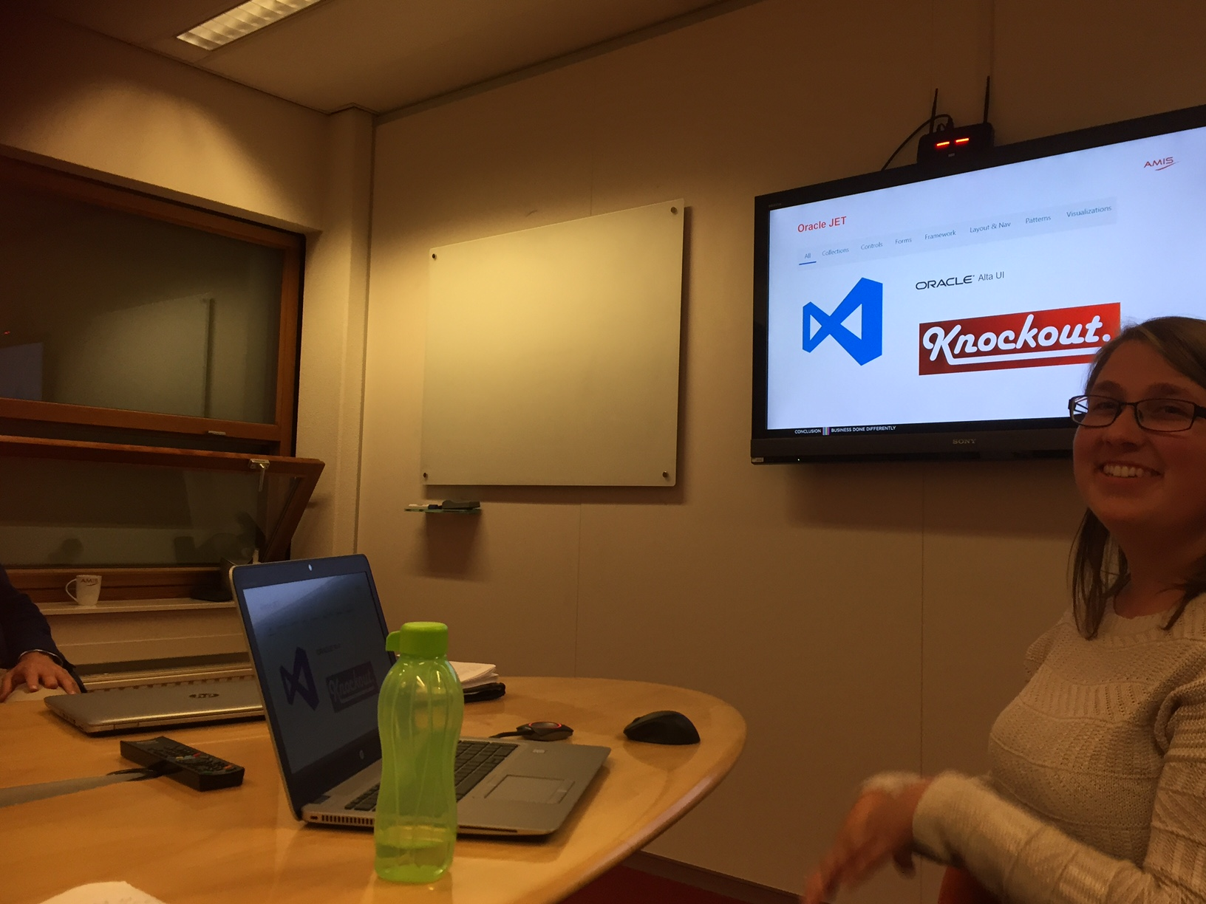
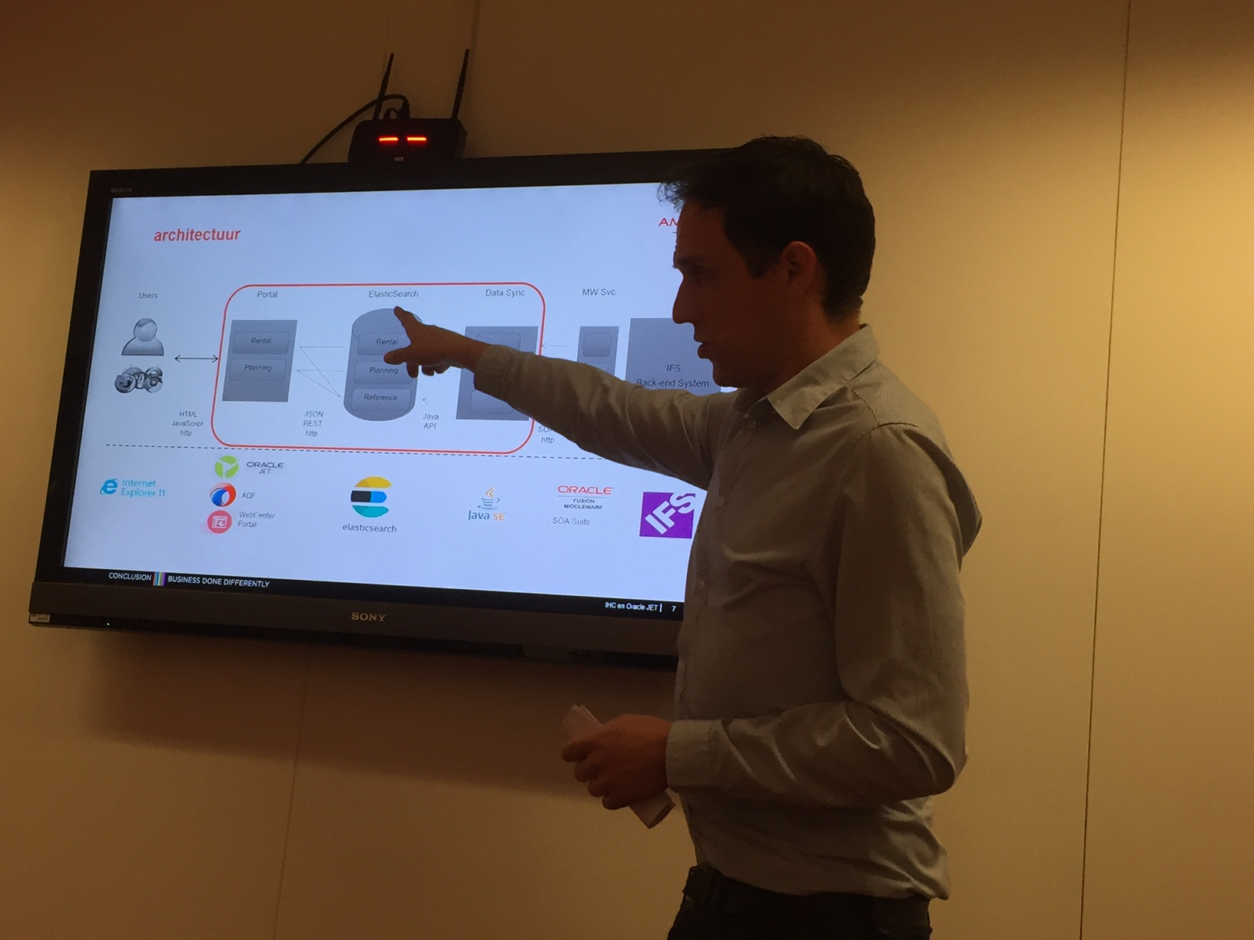
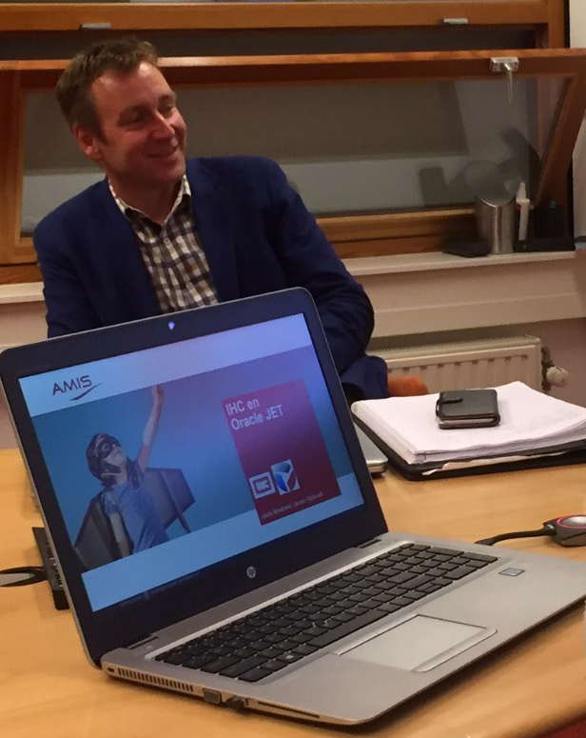
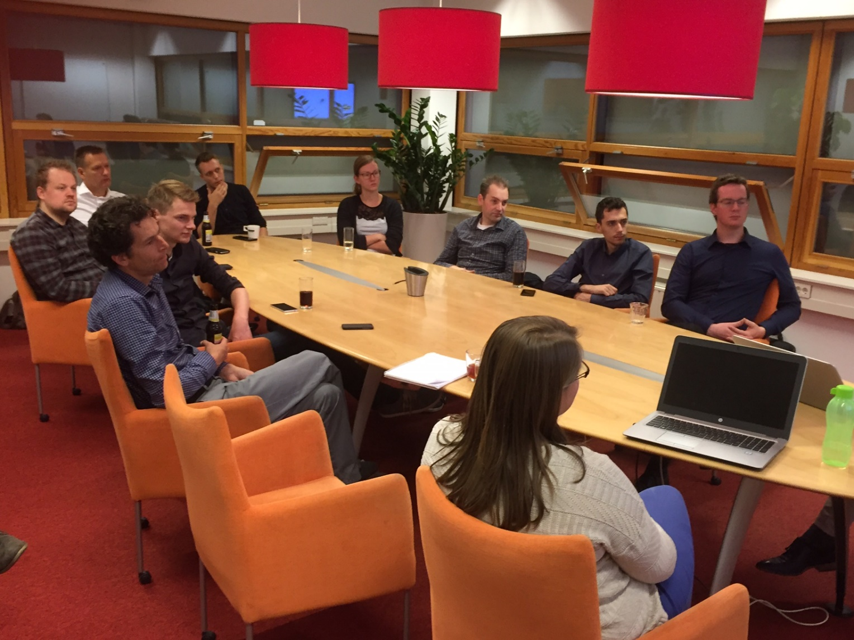
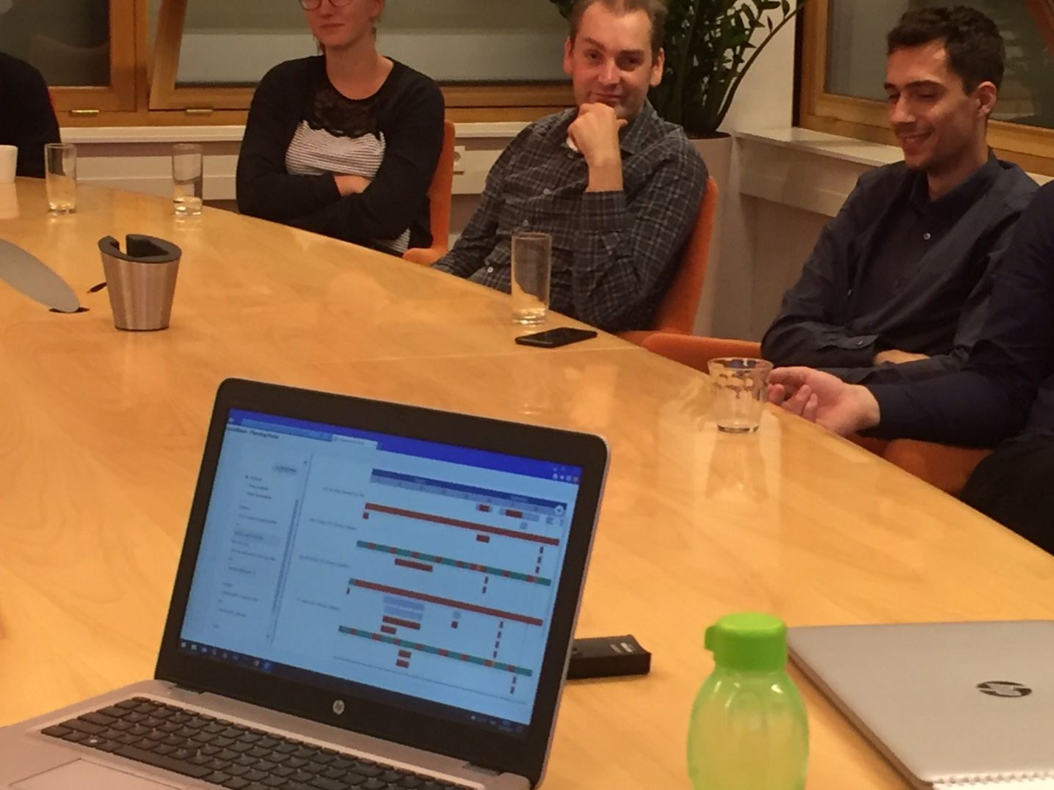

Slide 9

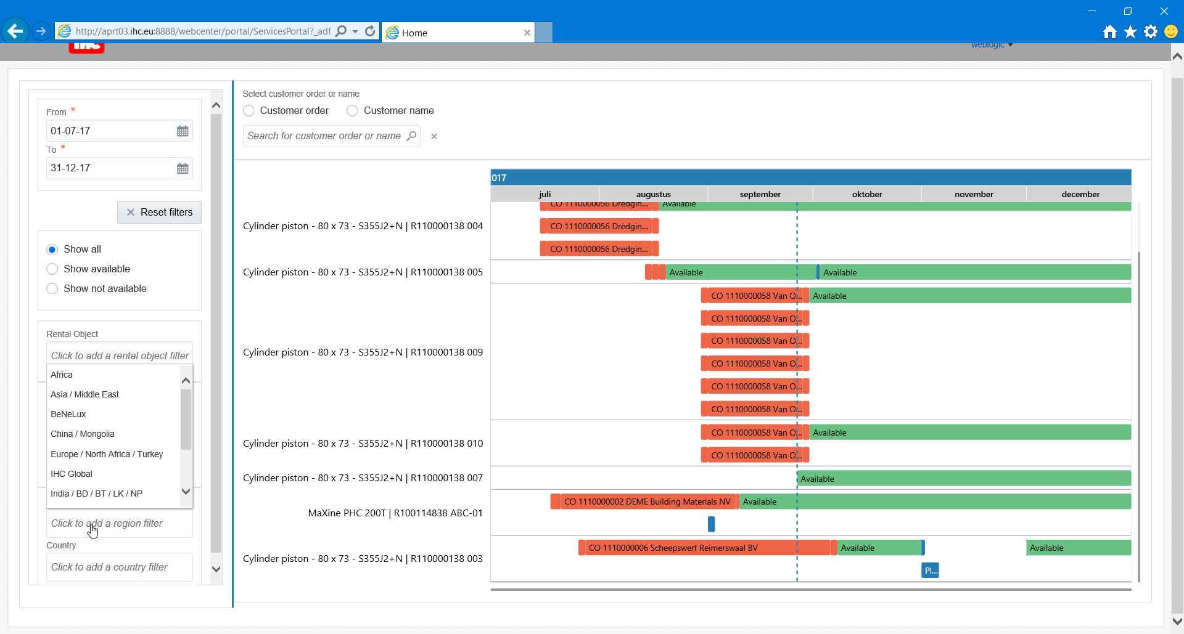
WebCenter Portal

Slide 10
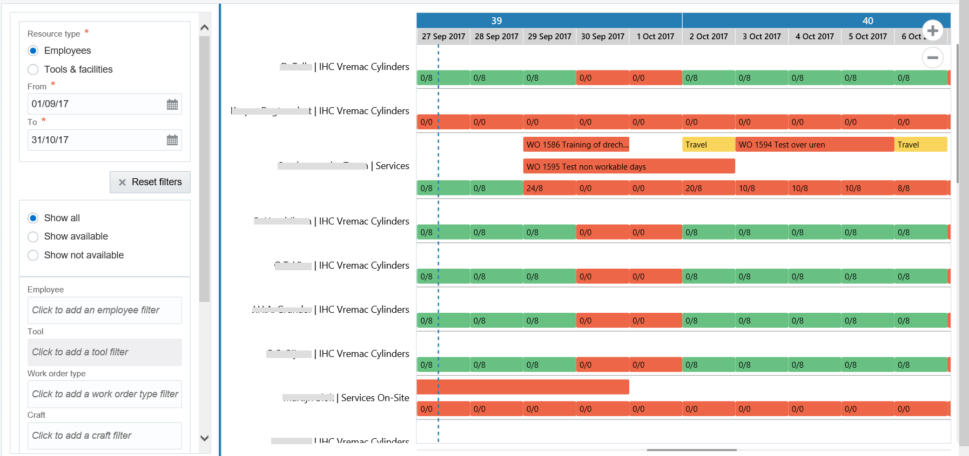

Slide 11
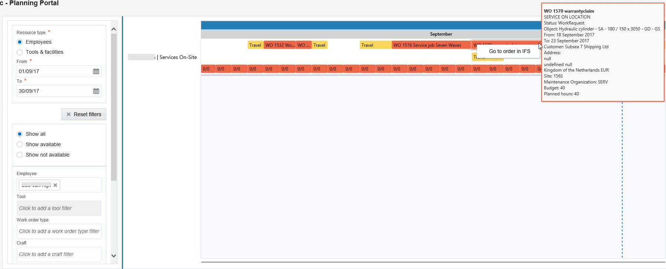

Slide 12
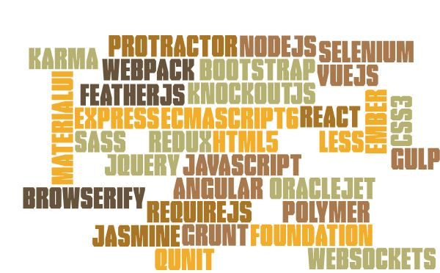
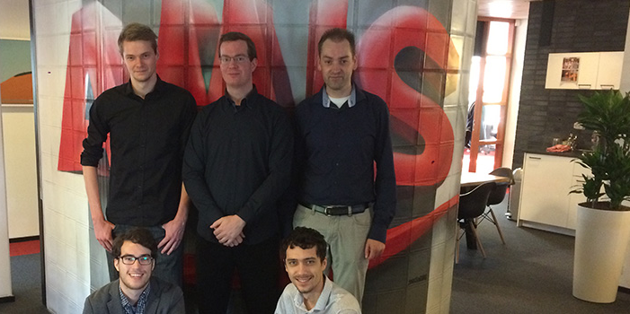
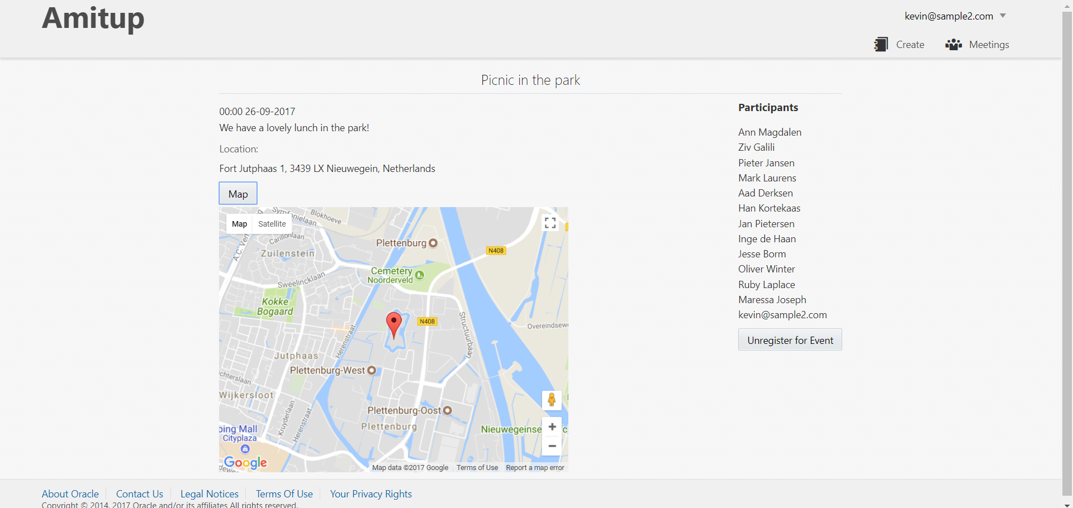
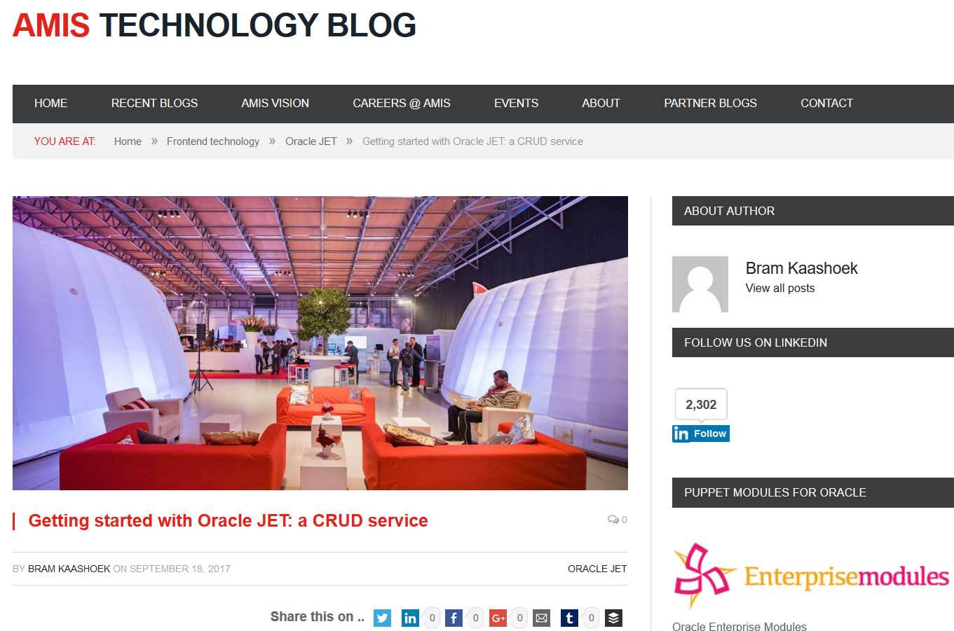
Fresh out of the gate (September 2017): 5 brand new Oracle JET developers

Slide 13
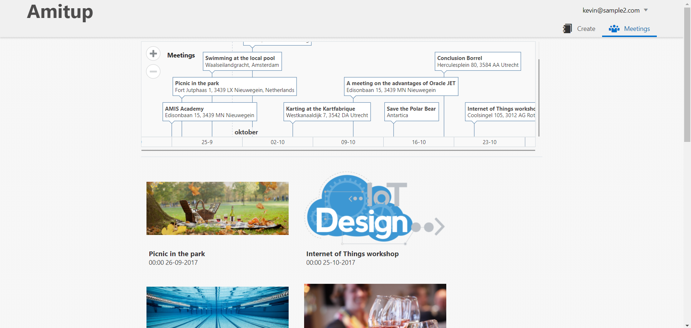
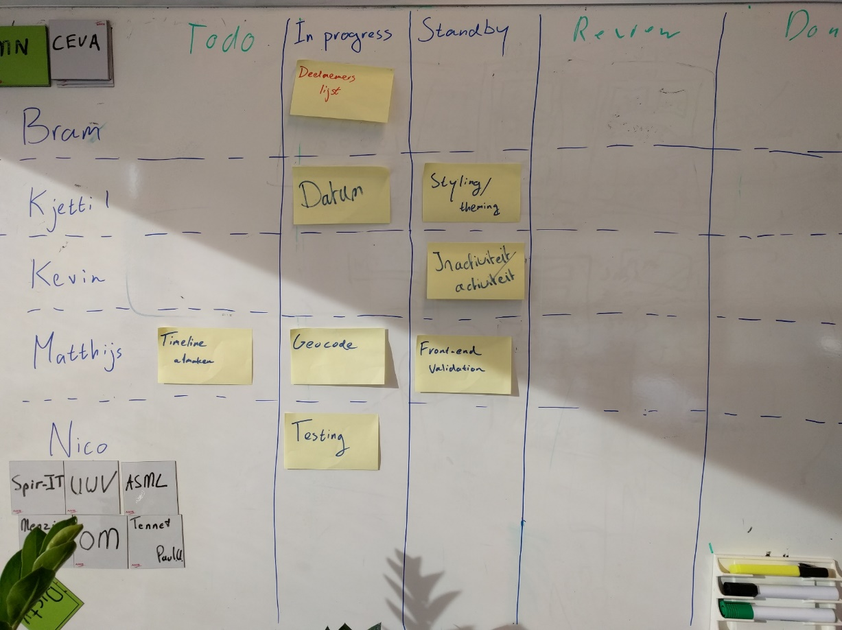
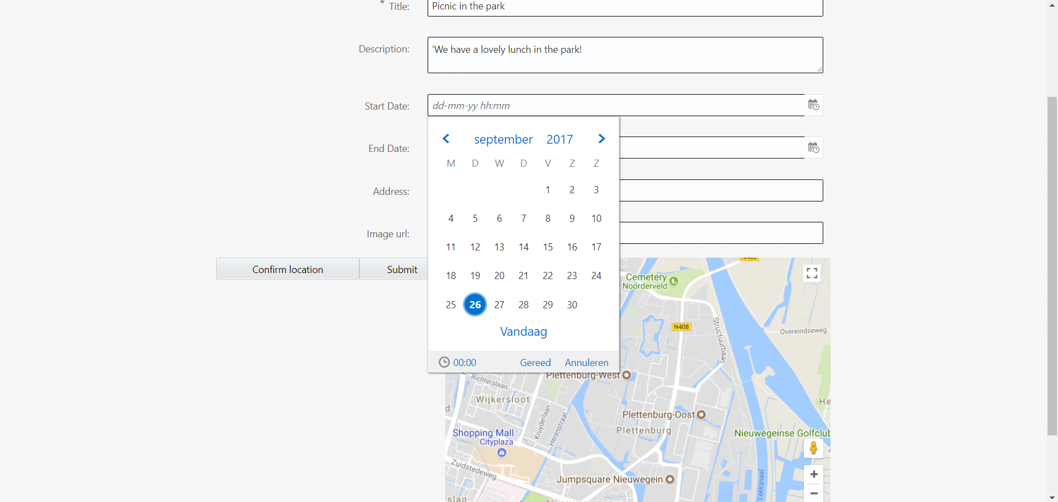
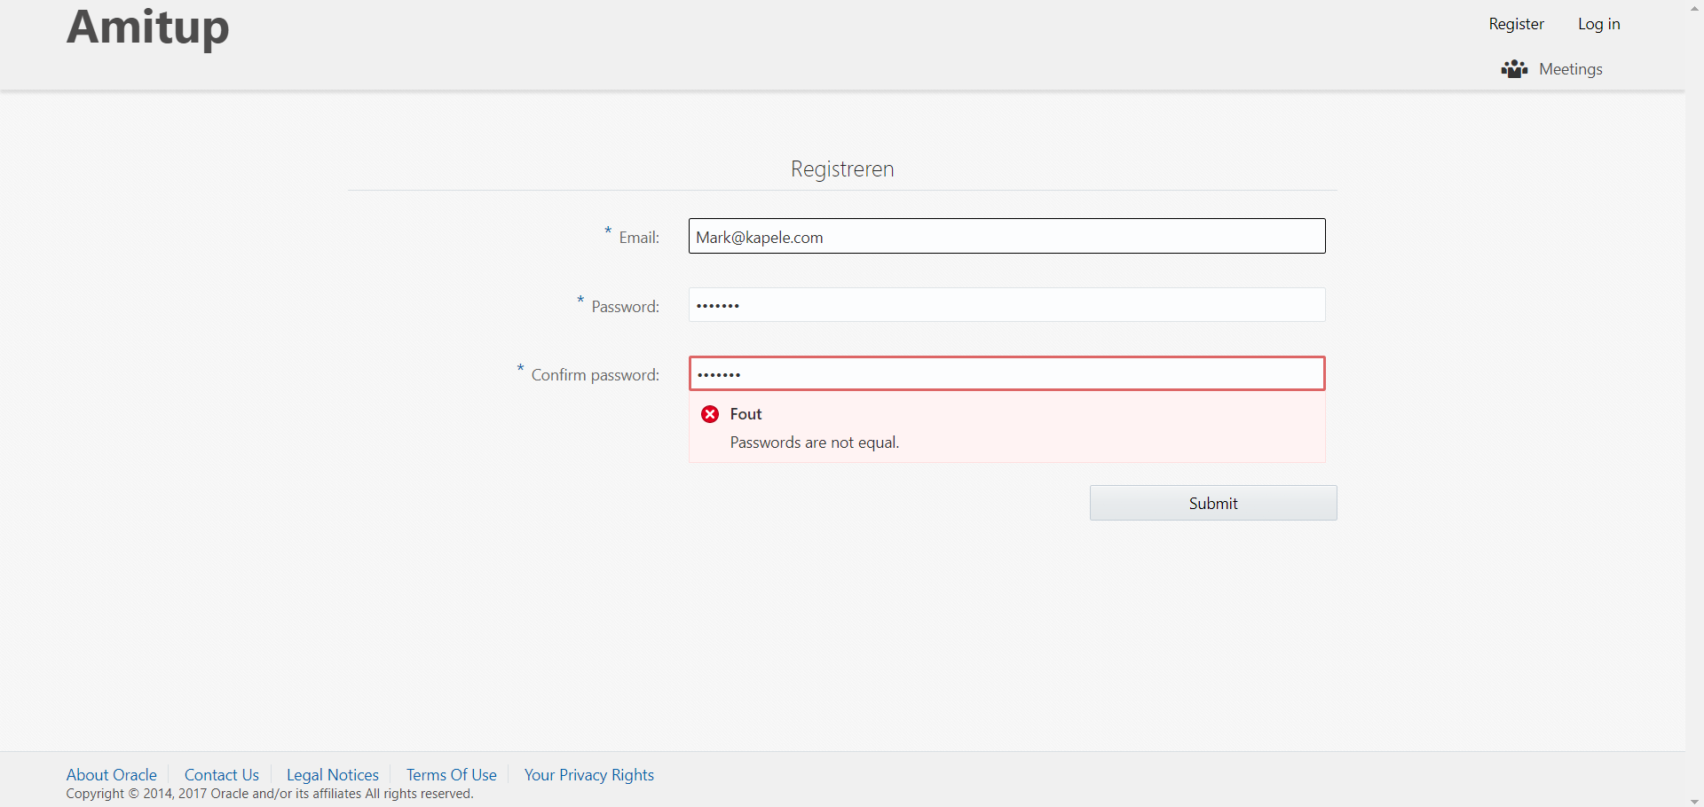

Slide 14



Blog: technology.amis.nl
Email: lucas.jellema@amis.nl
: lucasjellema
: lucas-jellema
: www.amis.nl, info@amis.nl +31 306016000 Edisonbaan 15, Nieuwegein

